Slide 1
Language Engineering Assignment 2
Xuecong Liu

Slide 2
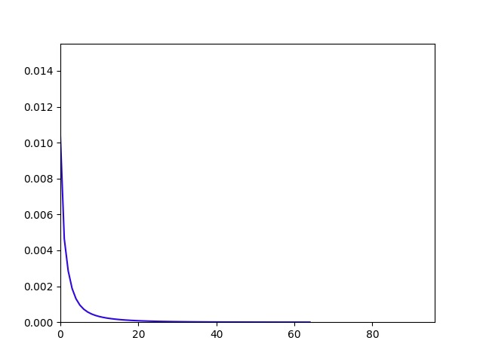
Batch Gradient Descent
Model parameters
0: -3.5557
1:5.8118
2: -3.0430
Confusion Matrix
 |  | Real | Classes
 |  | 0 | 1
Predicted | 0 | 83831 | 3242
classes | 1 | 879 | 12046
Sum of squared gradients - Number of 100 iterations
Learning rate: 0.1

Slide 3
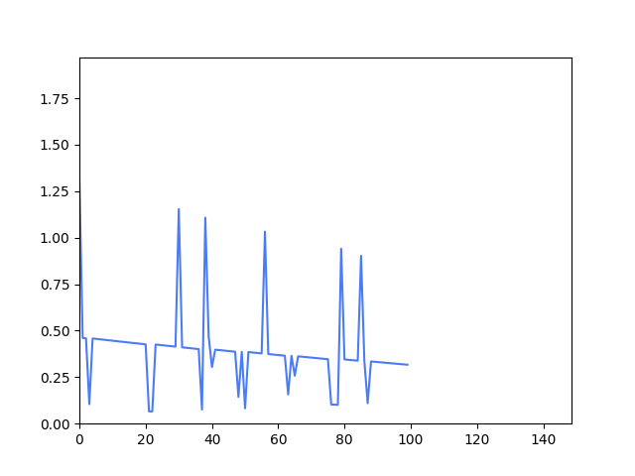
Stochastic Gradient Descent (100 iterations)
Model parameters
0: 0.2477
1:0.8720
2: -1.0107
Confusion Matrix
 |  | Real | Classes
 |  | 0 | 1
Predicted | 0 | 101 | 47
classes | 1 | 84609 | 15241
Sum of squared gradients - Number of iterations
Learning rate: 0.01

Slide 4
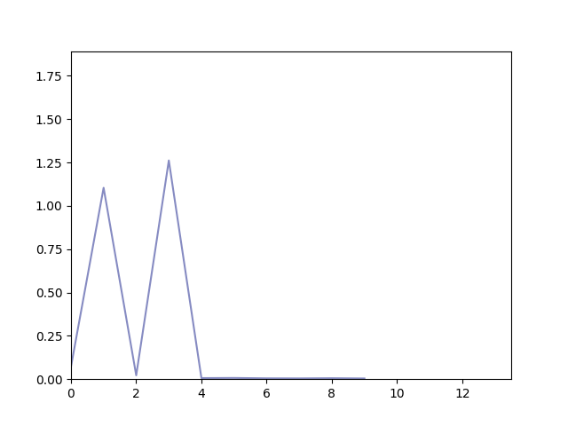
Stochastic Gradient Descent (1000 iterations)
Model parameters
0: -2.7120
1: 4.0581
2: -0.9241
Confusion Matrix
 |  | Real | Classes
 |  | 0 | 1
Predicted | 0 | 80674 | 2015
classes | 1 | 4036 | 13273
Sum of squared gradients - Number of iterations
Learning rate: 0.1

Slide 5
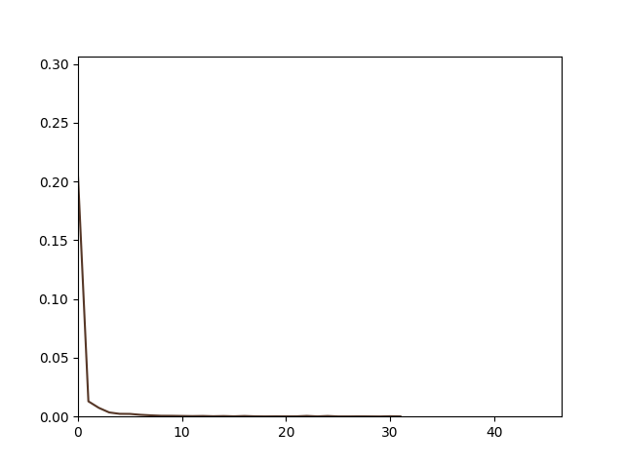
Minibatch Gradient Descent
Model parameters
0: -3.4206
1: 5.2573
2: -2.2900
Confusion Matrix
 |  | Real | Classes
 |  | 0 | 1
Predicted | 0 | 83831 | 3242
classes | 1 | 879 | 12046
Sum of squared gradients - Number of iterations
Learning rate: 0.1

Slide 6

Accuracy, Precision and Recall
$$accuracy=\frac{TP+TN}{TP+TN+FP+FN}$$
$$precision=\frac{TP}{TP+FP}$$
$$recall=\frac{TP}{TP+FN}$$

Slide 7
Accuracy, Precision and Recall
Method | Accuracy | Precision (no name) | Recall (no name) | Precision (name) | Recall (name)
Batch | 95.88% | 96.28% | 98.96% | 93.20% | 78.79%
Stochastic (100) | 15.34% | 68.24% | 0.12% | 15.26% | 99.70%
Stochastic (1000) | 93.95% | 97.56% | 95.24% | 76.68% | 86.81%
Minibatch | 95.88% | 96.28% | 98.96% | 93.20% | 78.79%

Slide 8
Accuracy, Precision and Recall
Method | Accuracy | Precision (no name) | Recall (no name) | Precision (name) | Recall (name)
Batch | 95.88% | 96.28% | 98.96% | 93.20% | 78.79%
Stochastic (100) | 15.34% | 68.24% | 0.12% | 15.26% | 99.70%
Stochastic (1000) | 93.95% | 97.56% | 95.24% | 76.68% | 86.81%
Minibatch | 95.88% | 96.28% | 98.96% | 93.20% | 78.79%
Add feature: contains punctuation or Arabic numbers
Method | Accuracy | Precision (no name) | Recall (no name) | Precision (name) | Recall (name)
Batch | 96.08% | 96.51% | 98.96% | 93.28% | 80.19%
Stochastic (100) | 84.71% | / | / | / | /
Stochastic (1000) | 93.95% | 97.56% | 95.24% | 76.68% | 86.82%
Minibatch | 96.09% | 96.51% | 98.96% | 93.28% | 80.19%

Slide 9
Accuracy, Precision and Recall
Model parameters
0: -3.8818
1: 6.0699
2: -3.0565
3: 1.4030
Add feature: contains punctuation or Arabic numbers
Method | Accuracy | Precision (no name) | Recall (no name) | Precision (name) | Recall (name)
Batch | 96.08% | 96.51% | 98.96% | 93.28% | 80.19%
Stochastic (100) | 84.71% | / | / | / | /
Stochastic (1000) | 93.95% | 97.56% | 95.24% | 76.68% | 86.82%
Minibatch | 96.09% | 96.51% | 98.96% | 93.28% | 80.19%

